Slide 1
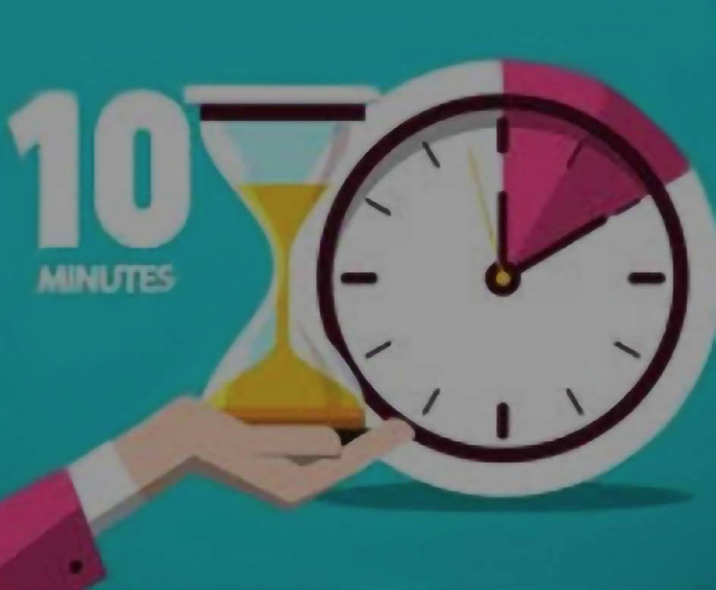
Take 10 with 4-H
Communication
Notes:
Welcome to Take 10 with 4-H
Take 10 with 4-H was created as an idea sharing and learning opportunity for 4-H volunteers at the recommendation of the Volunteer Development Workgroup which is made up of 4-H agents from each District in NM
Todays topic is Communiocation

Slide 2
Communication is…
Important
Research says 7% of communication is verbal, 55% is body language, and 38% the tone and inflection.
Companies lose an average of $62.4 million per year because of miscommunications among employees. (SHRM, 2020)
57% of recruiters say there will be a growth in demand for interpersonal skills over the next five years (MBA.com, 2021)
https://connectedspeechpathology.com/blog/how-to-improve-communication-skills

Slide 3
Continual
In-Person
Texts
Emails
Phone Calls
Social Media
Clear and Concise Communication is worth the effort!

Slide 4
Five Communication Skills
Necessary for Successful Communication
Listening
Repeat what you hear/Active Listening
Clear and Concise
Don’t assume the listener understands all acronyms or events
Be Aware of Non-verbal communication
55% of communication is body language
38% tone
Stress Awareness
Am I communicating during a stressful situation?
Emotion control
What are my emotions during this communication?

Slide 5
Why do we care about communication skills?
We work with youth…
Our EXAMPLE matters!
Important Life Skill for our youth
Poor communication – can lead to conflict and more work

Slide 6
Thank you!!

