Slide 1
Take 10 with 4-H
Senior Leadership Retreat (SLR)

Slide 2
Senior Leadership Retreat (SLR)
Who:
Senior 4-H Members
What:
3 Day (Friday-Sunday) Leadership Event
When:
January
Where:
Location alternates between Albuquerque and Las Cruces
How Much:
Cost varies from year to year

Slide 3
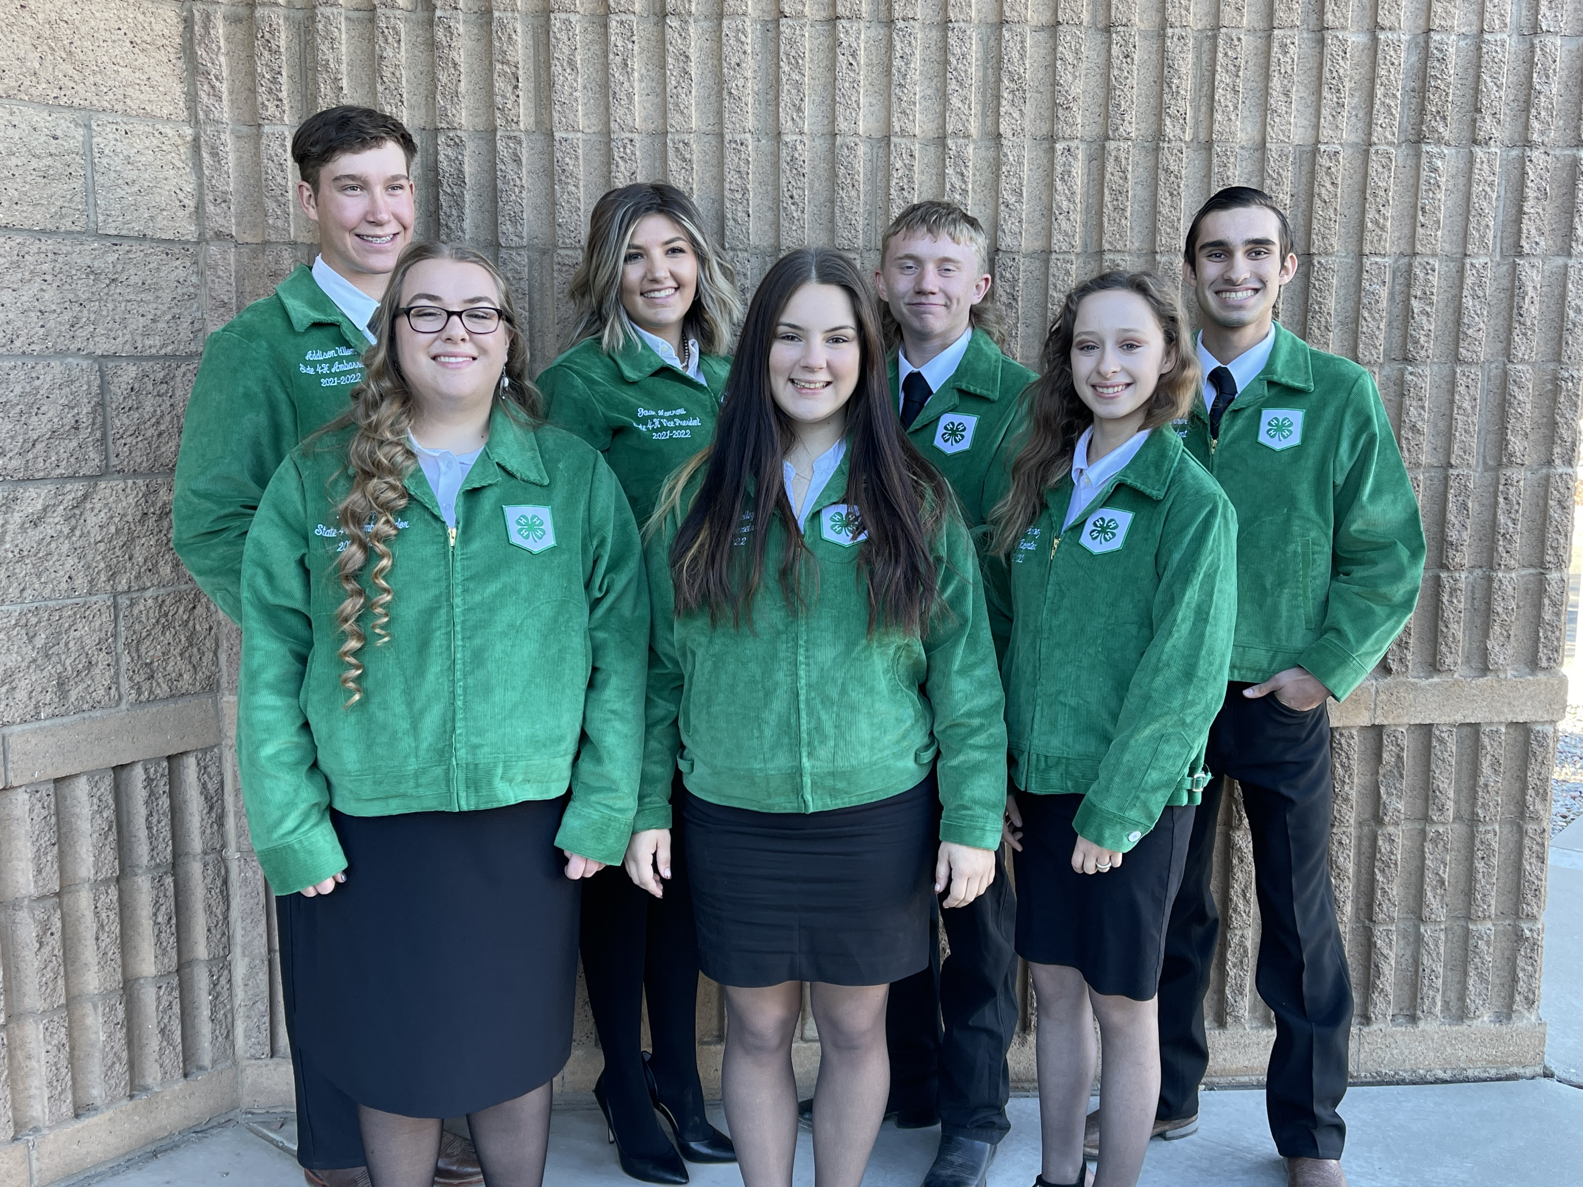
NM State 4-H Leadership Team
Provides leadership to statewide 4-H events including Senior Leadership Retreat (SLR)
Contribute to the planning details
Theme
Design
T-shirt Selection
Session Script Development
Individual Speeches
Workshop Presentations

Slide 4
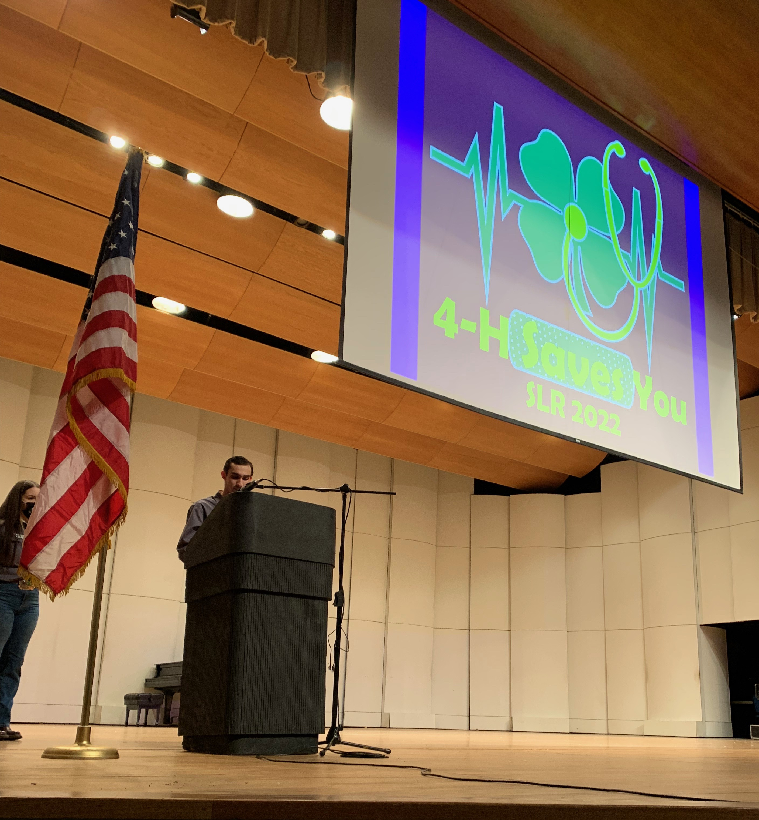
Sessions
Youth Led
Inspirational Speeches from Leadership Team Members

Slide 5
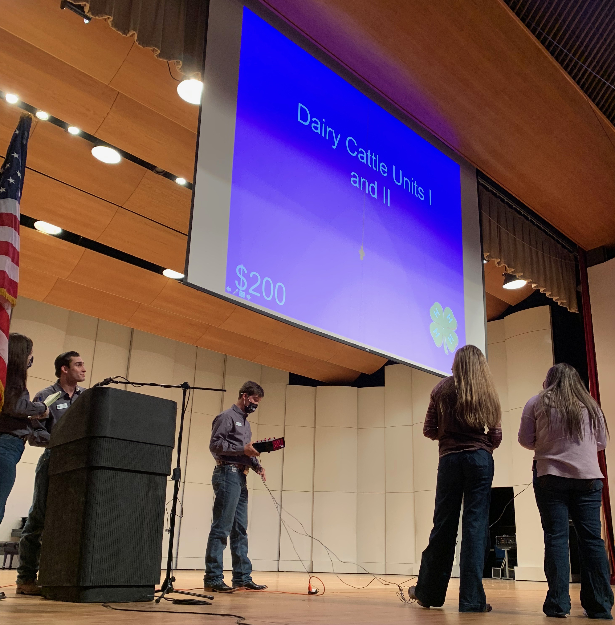
Sessions
Interactive Fun Games that challenge 4-H members from across the state like Minute-to-Win-It and 4-H Jeopardy

Slide 6
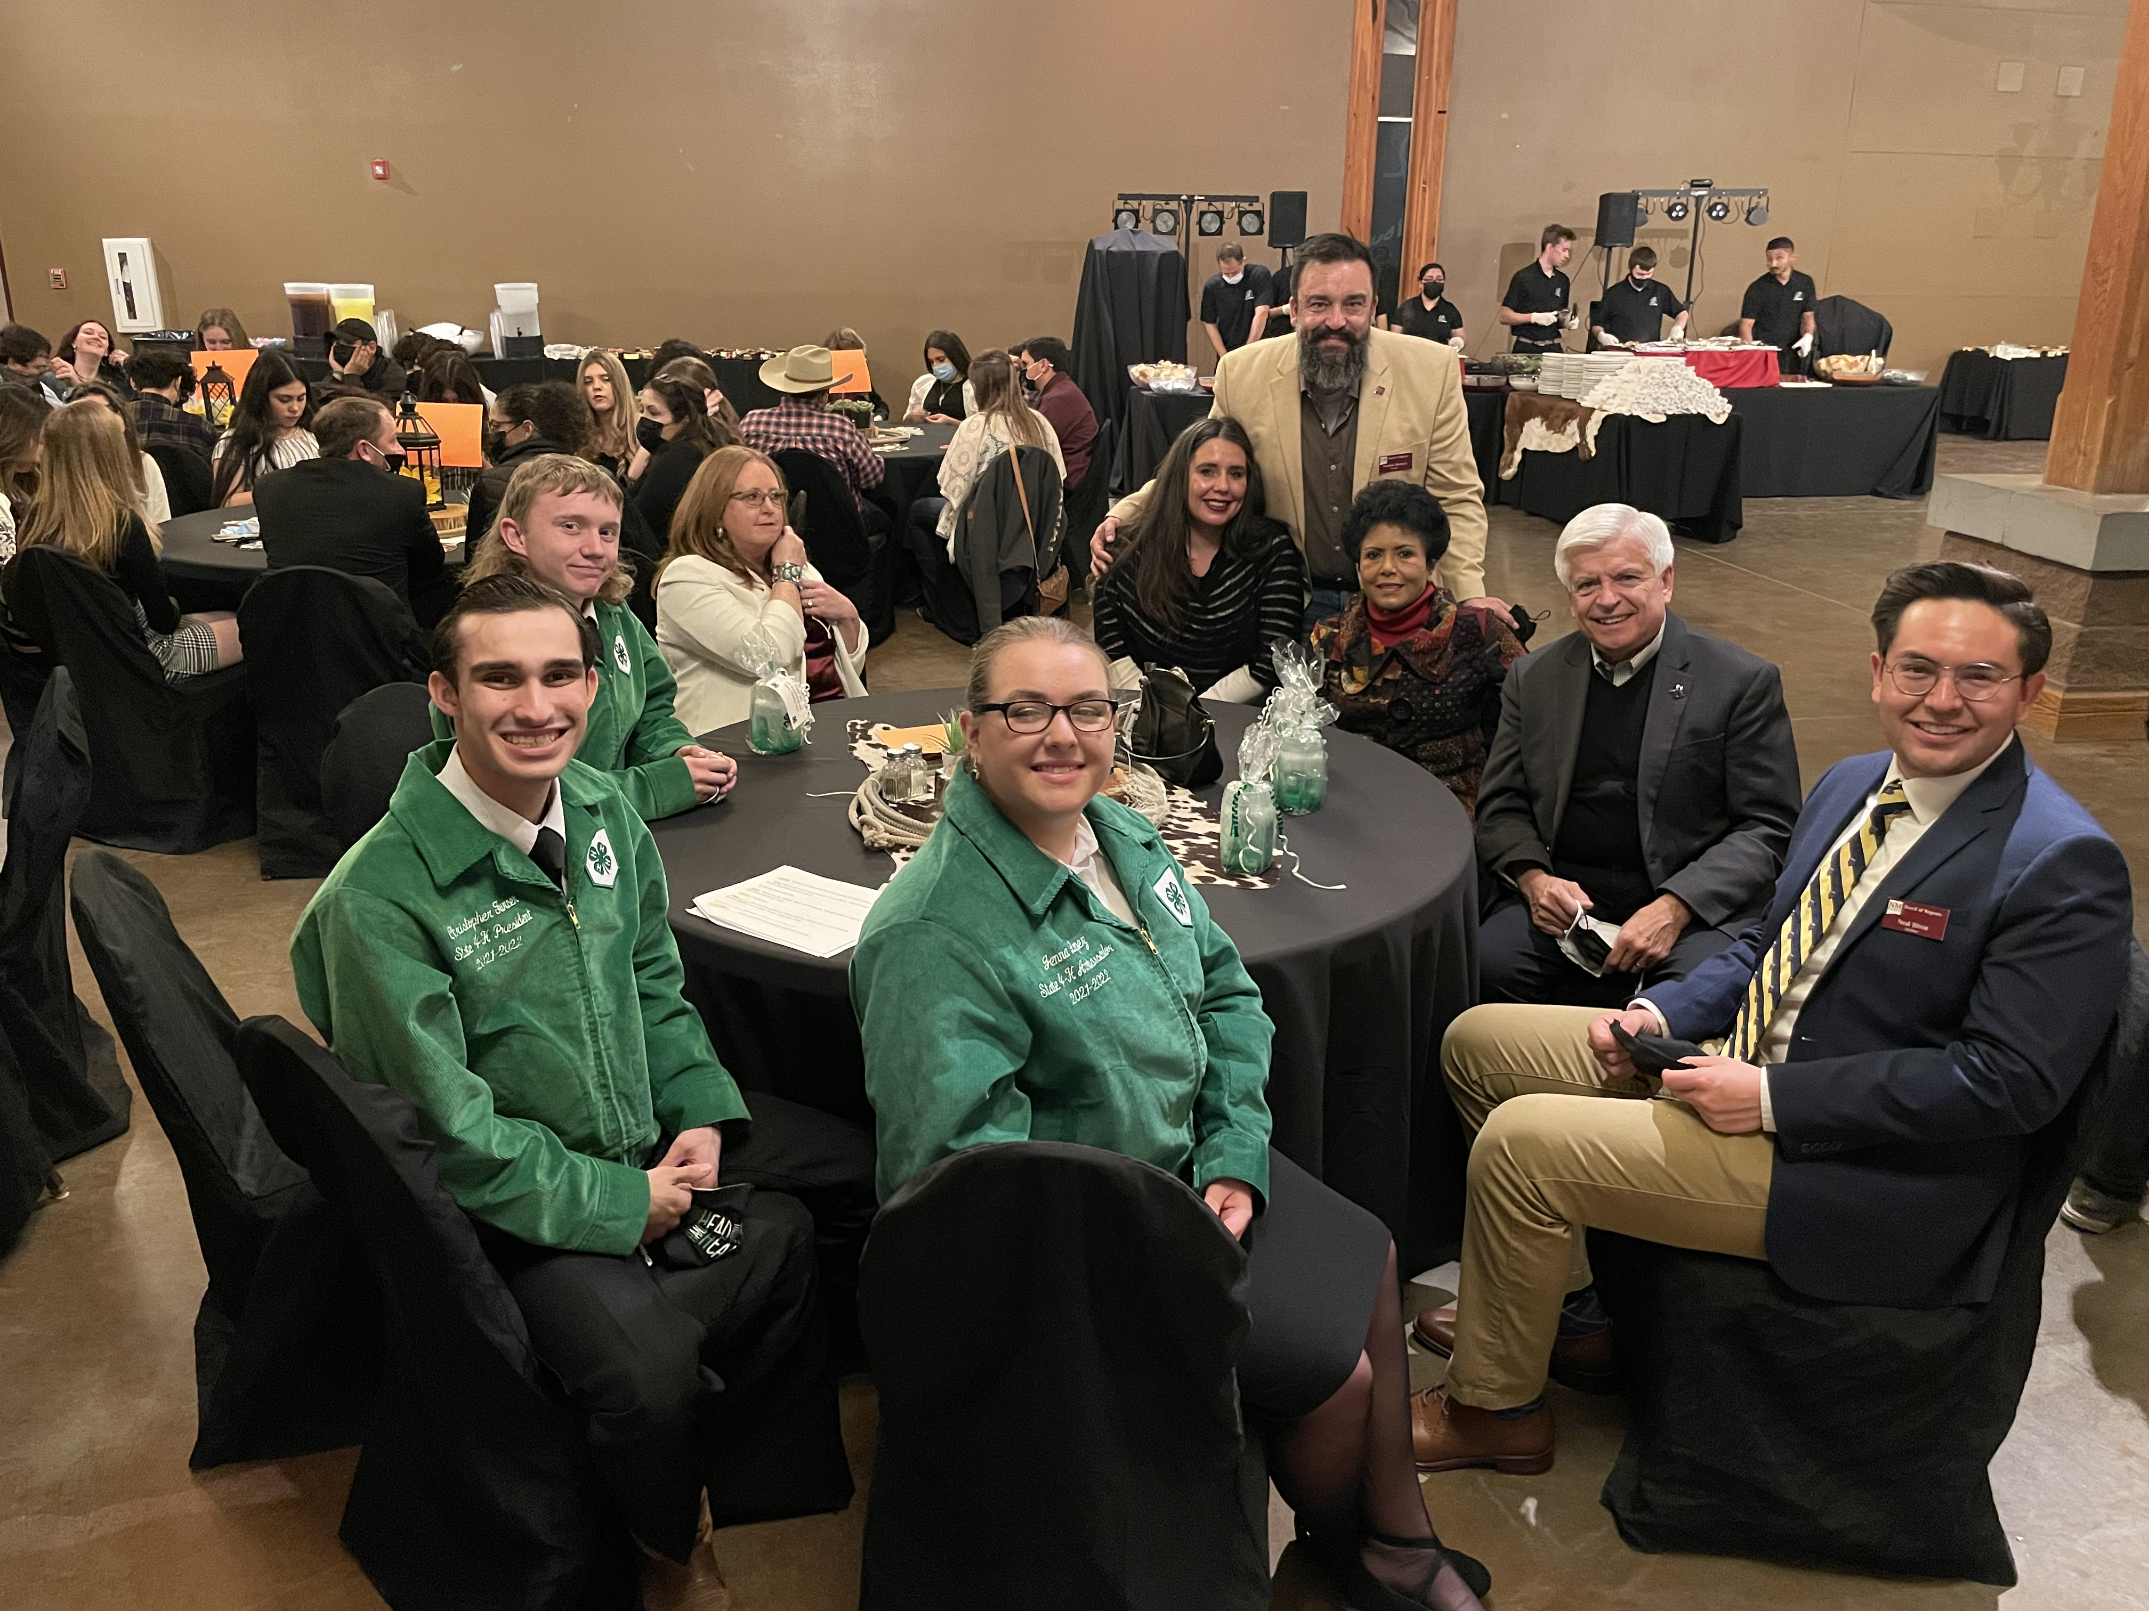
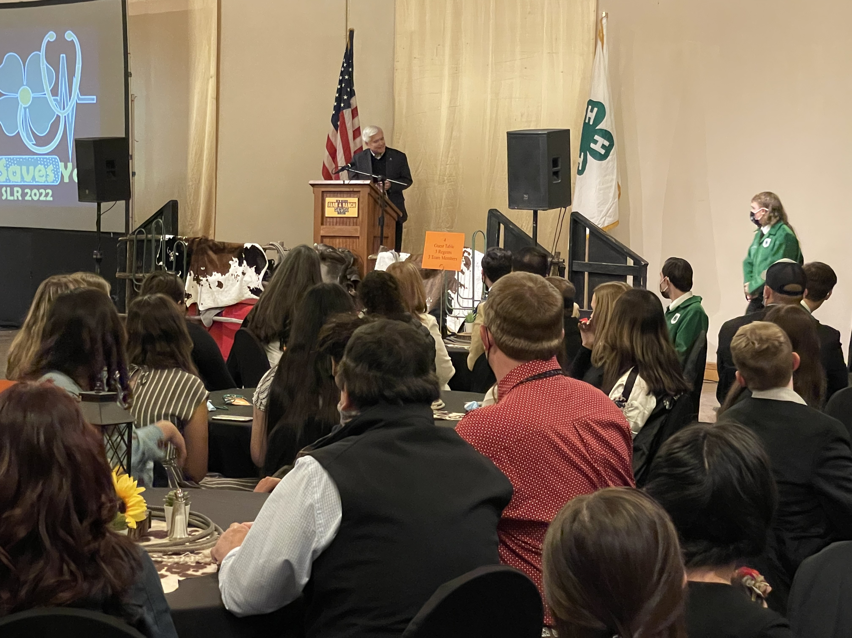
Sessions
Motivational Speakers
Guest Speakers
Special Guests

Slide 7
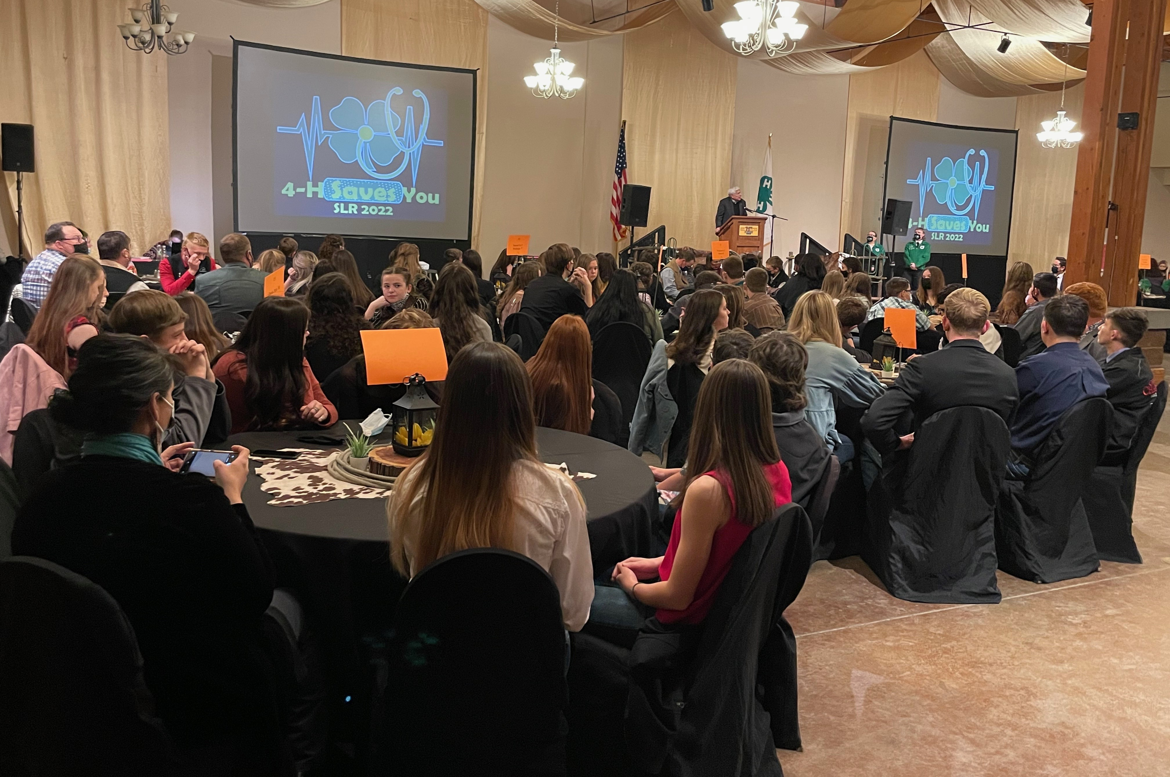
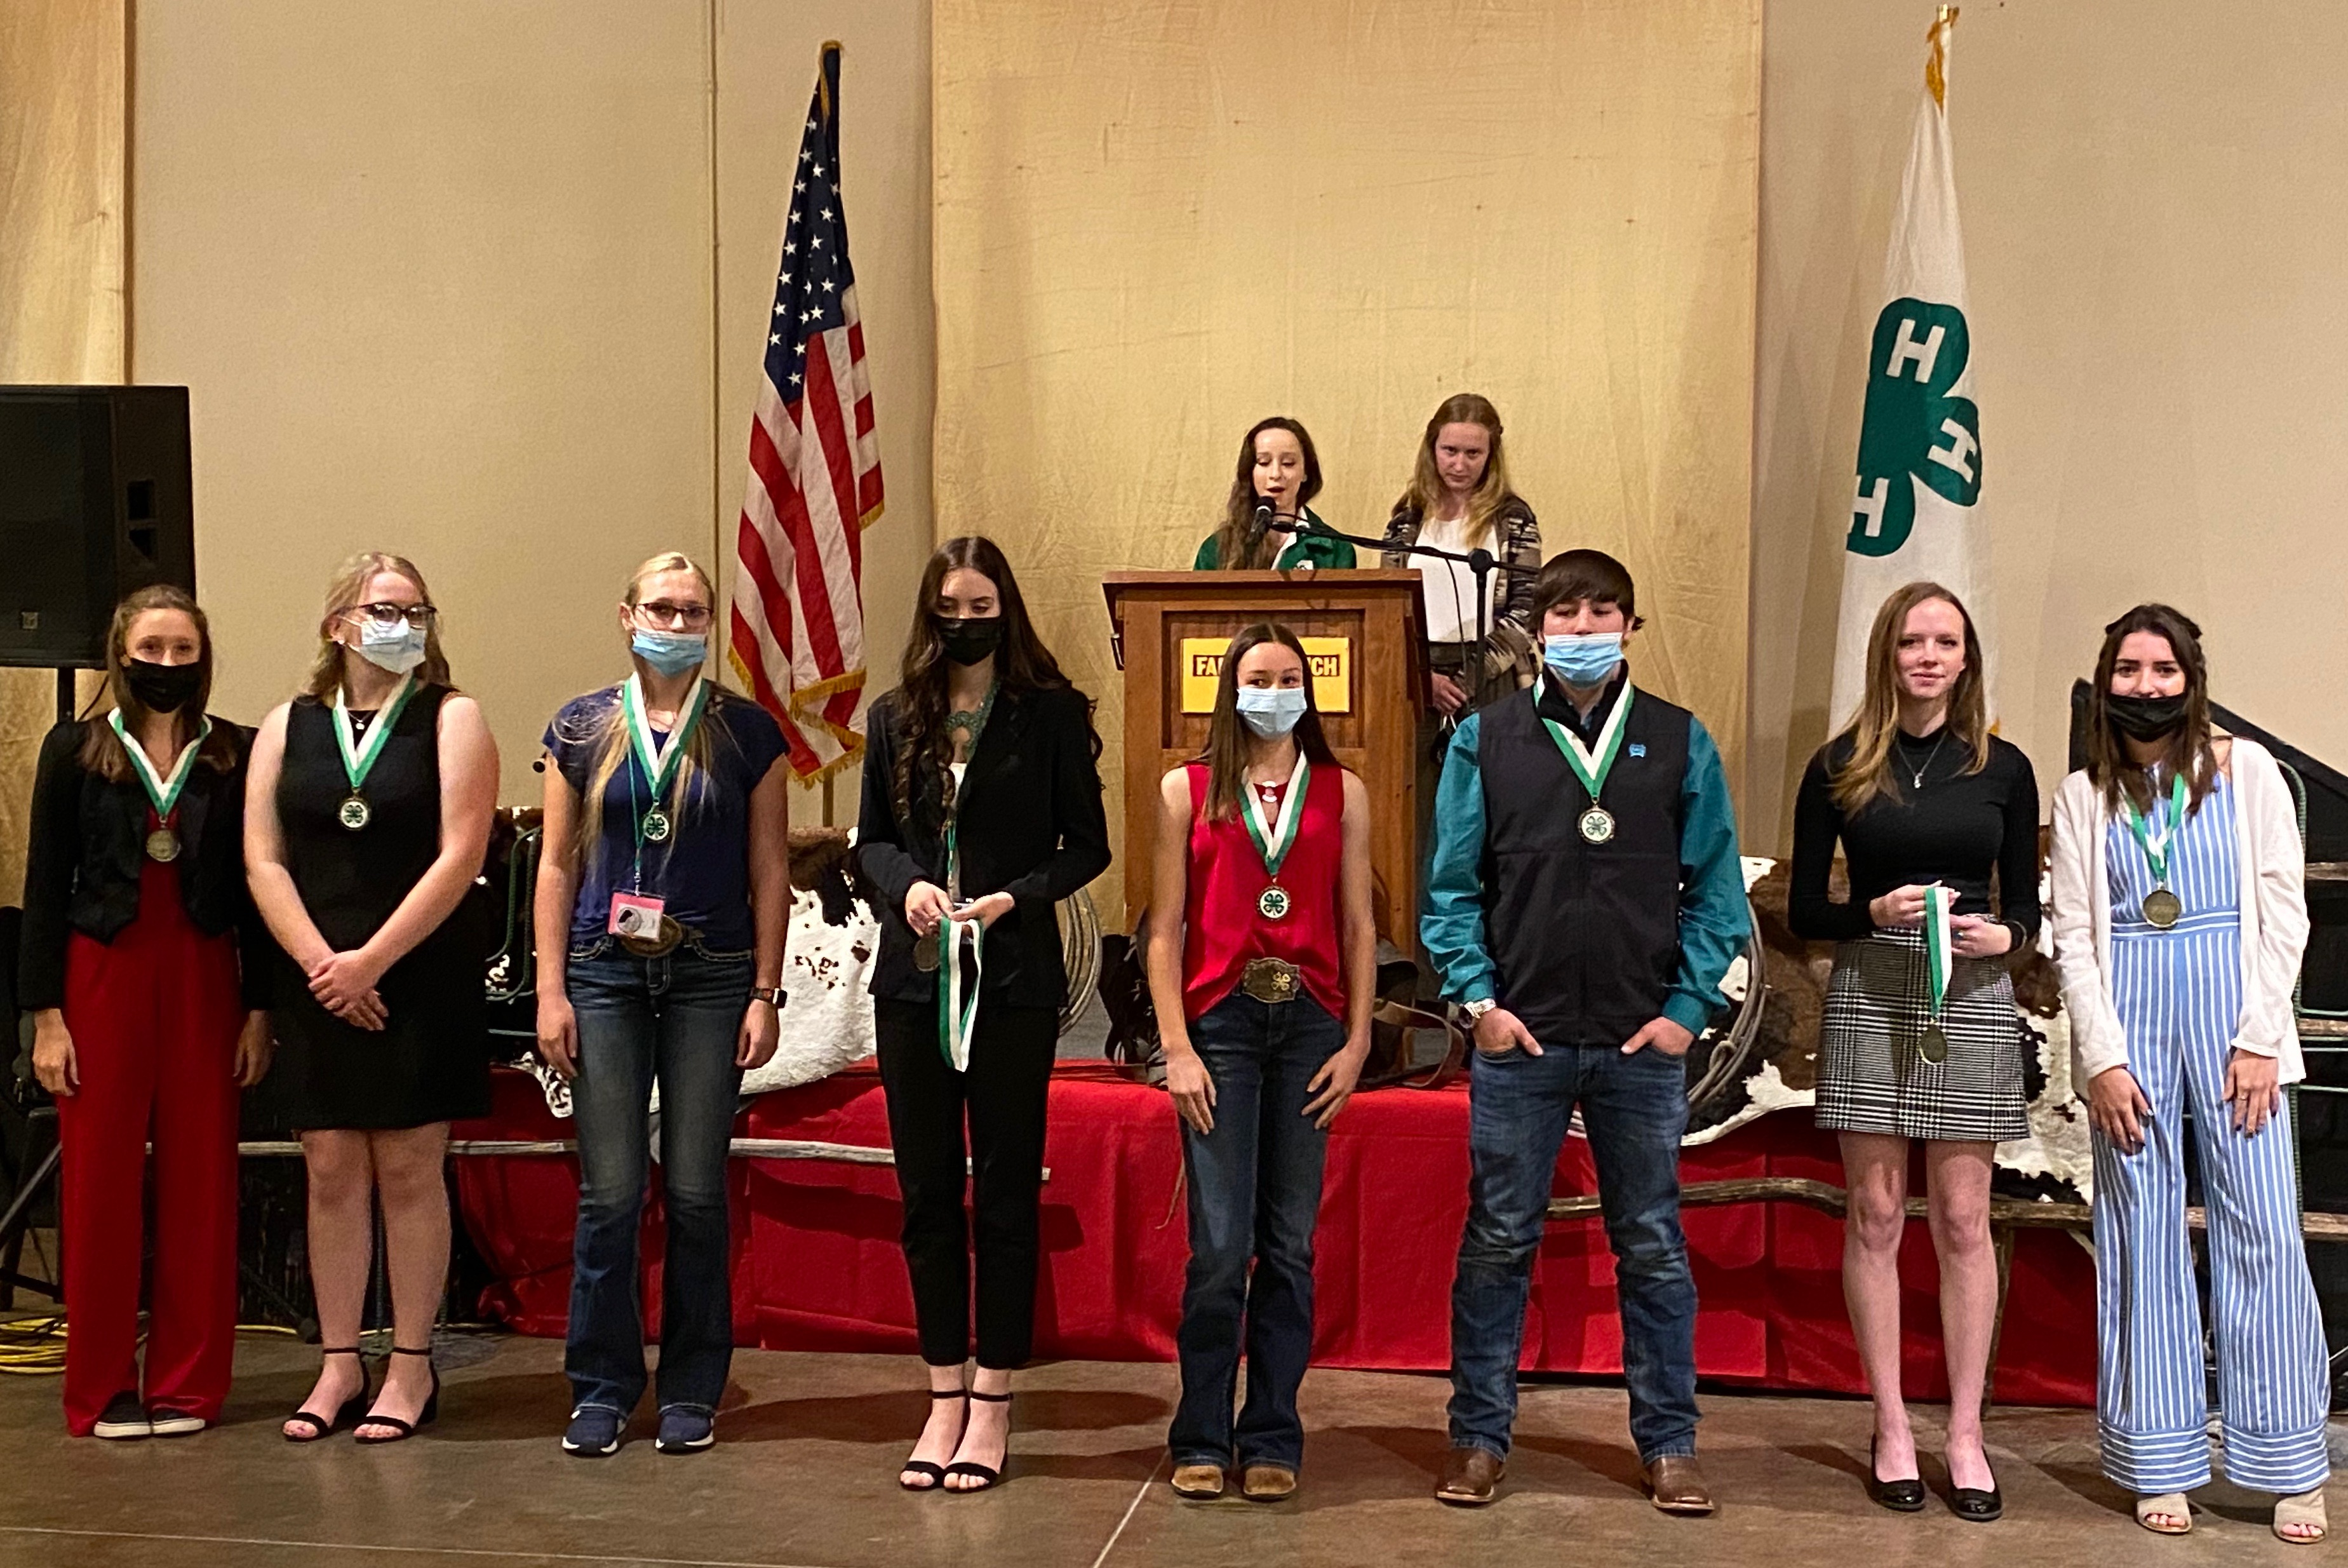
Banquet
The Saturday night session is set up in a banquet setting. The 4-Hers are asked to dress up for this session.
State Portfolio Winners Announced

Slide 8
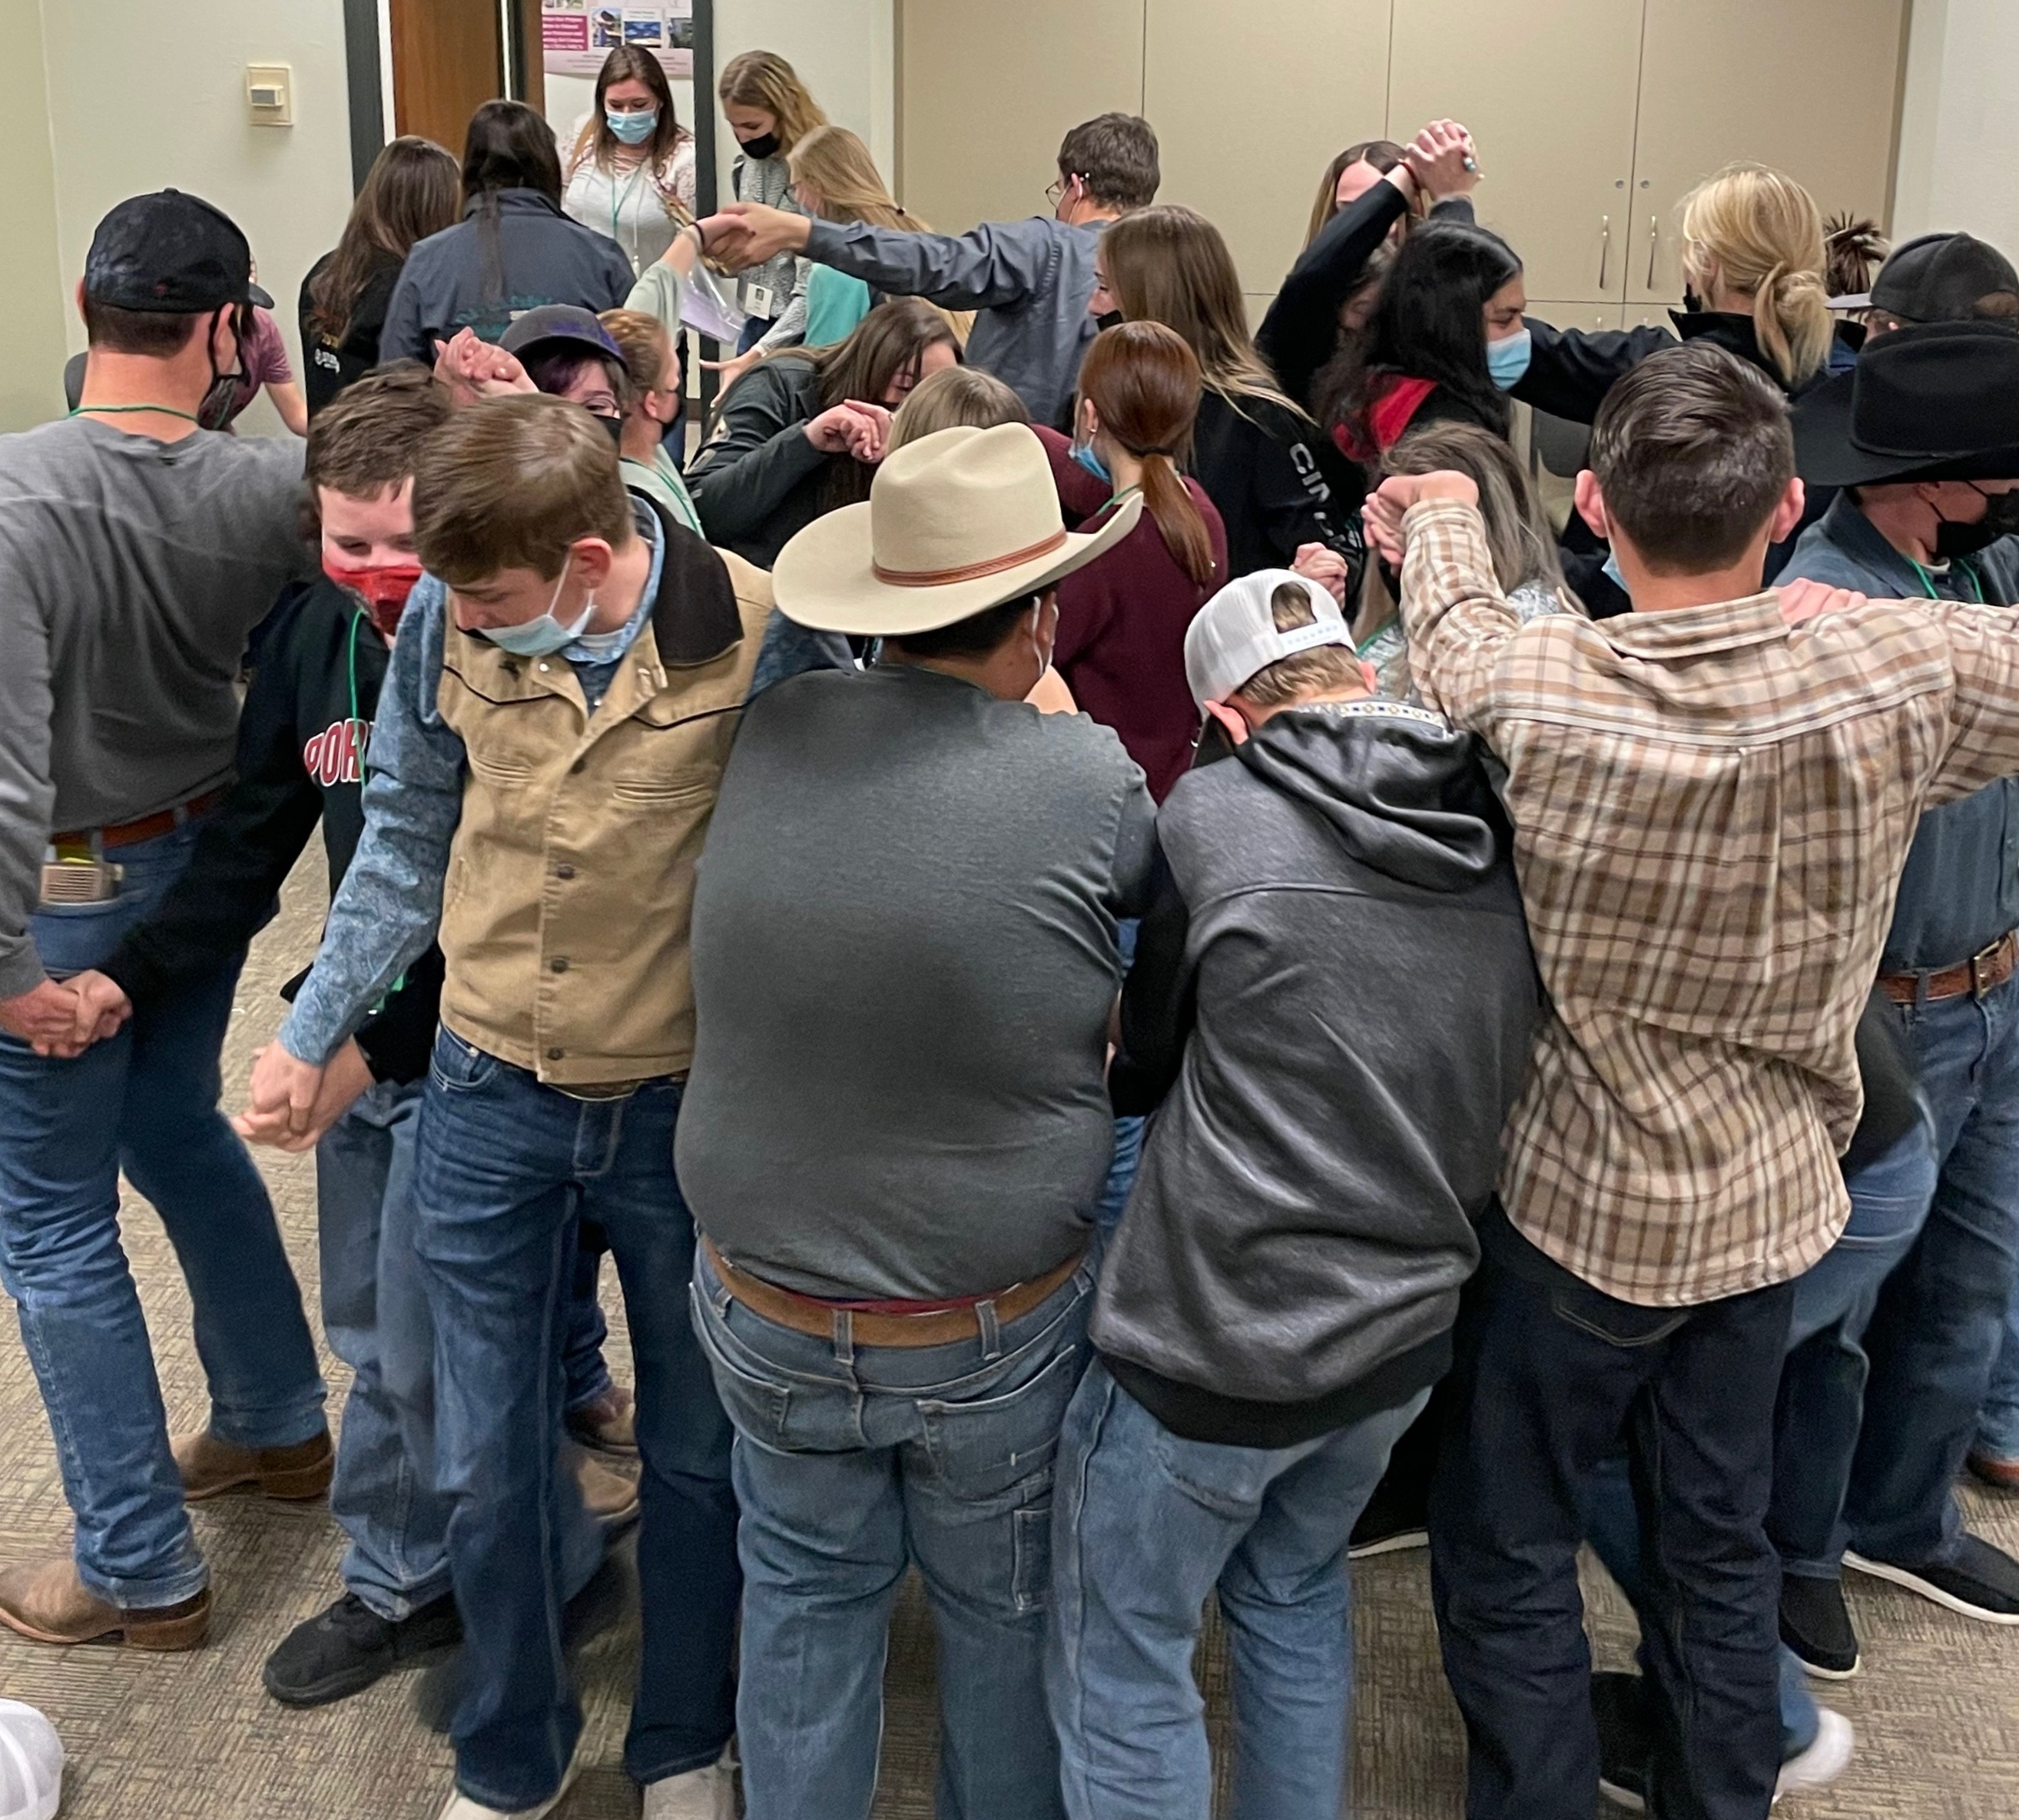
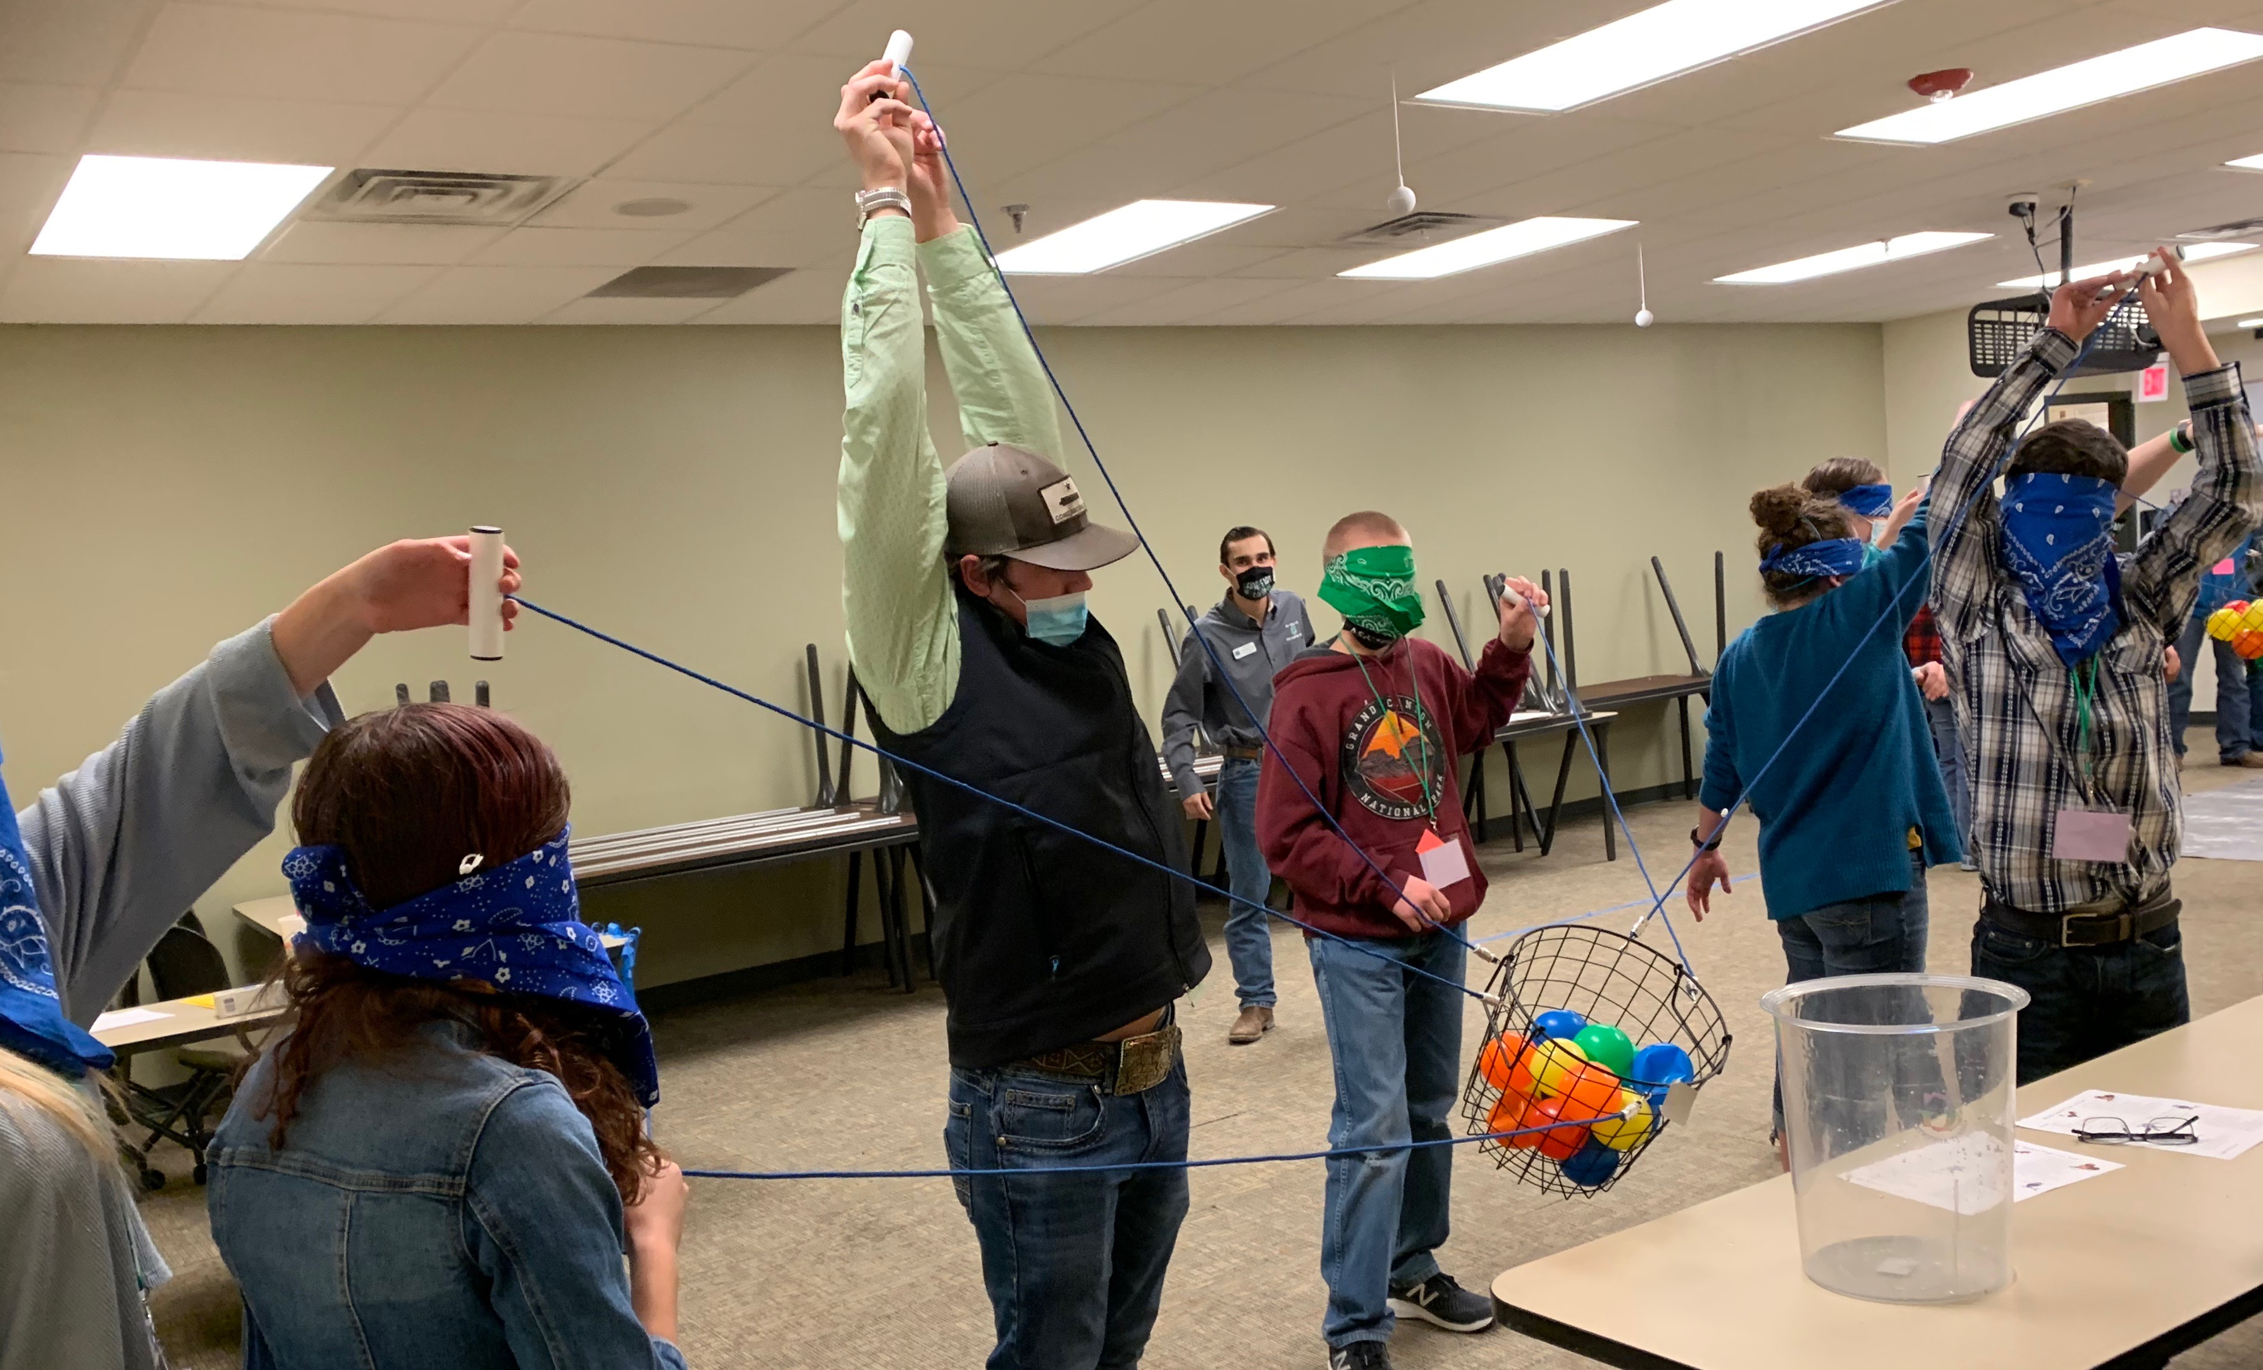
Workshop Topics
Self-Esteem
Confidence Building
Team Building
Communication Skills
Commitment
Goal Setting

Slide 9
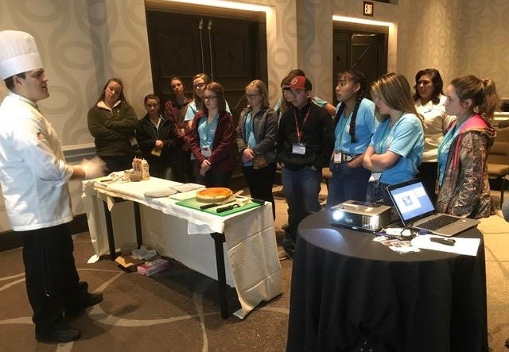
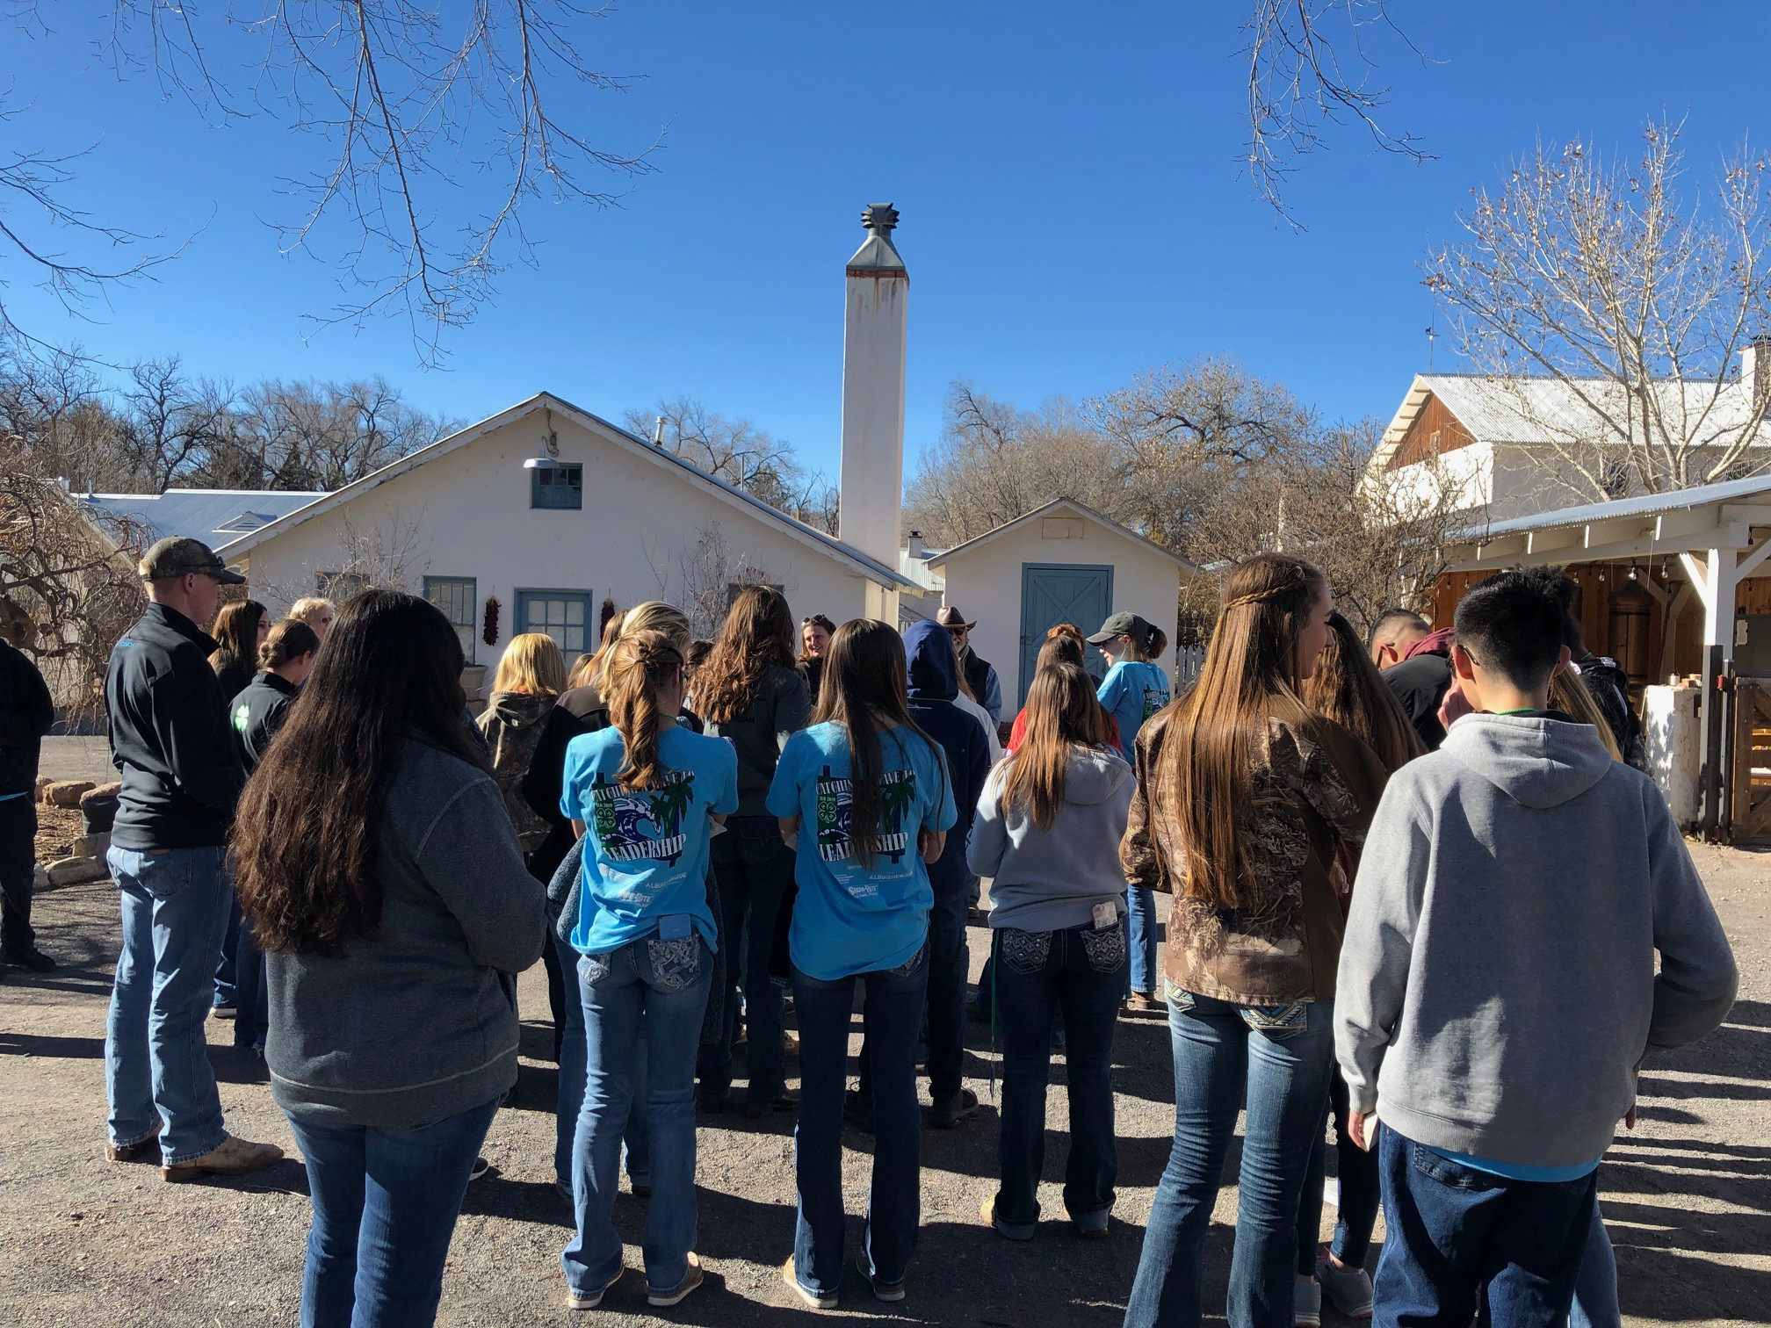
Workshops and/or Tours for Career Exploration
Senior Leadership Retreat (SLR) focuses on a mixture of career exploration opportunities depending on the location, including but not limited to career skills workshops, tours of different businesses and visits to New Mexico State University (NMSU) campus to learn about a variety of majors.

Slide 10
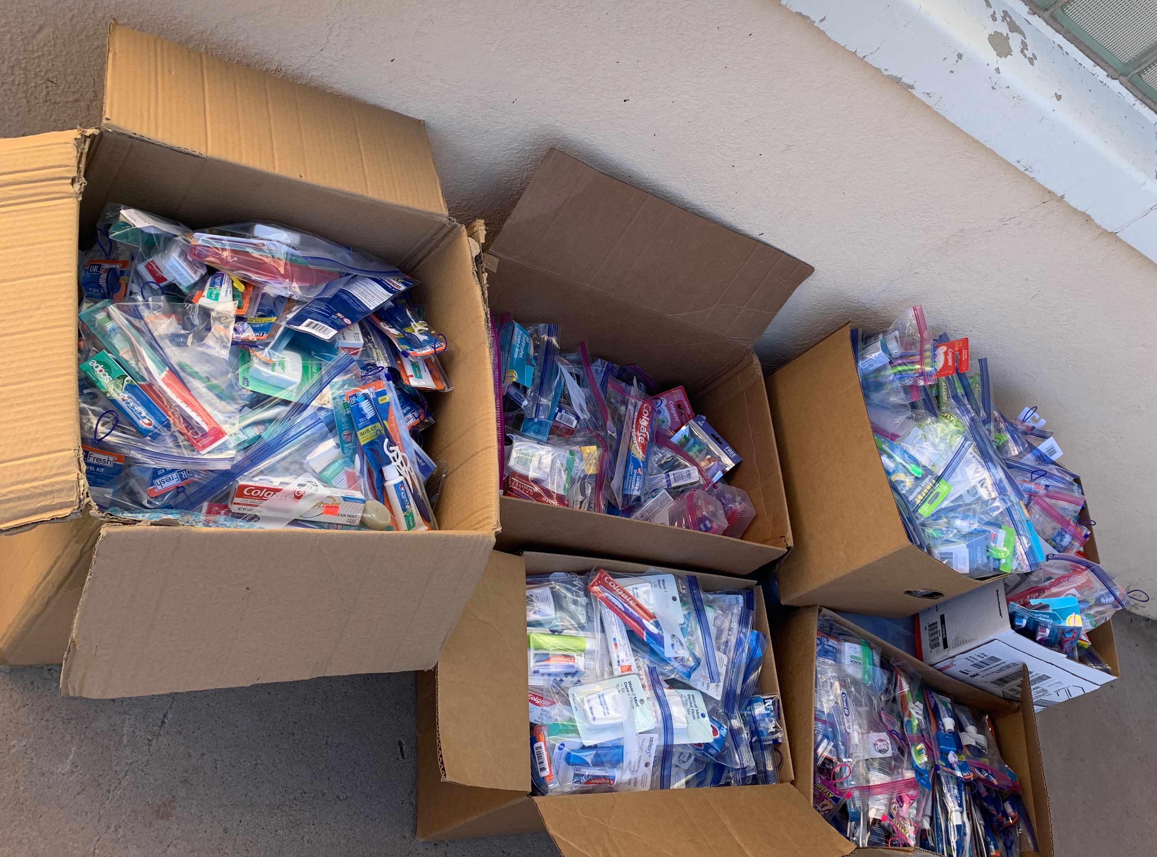
Community Service
The State 4-H Leadership Team selects a community service focus for Senior Leadership Retreat. 4-Hers (individually or as a county) bring items designated for the community service.

Slide 11
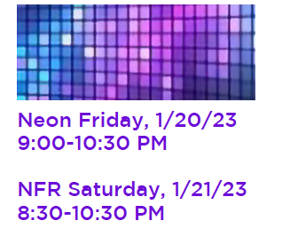
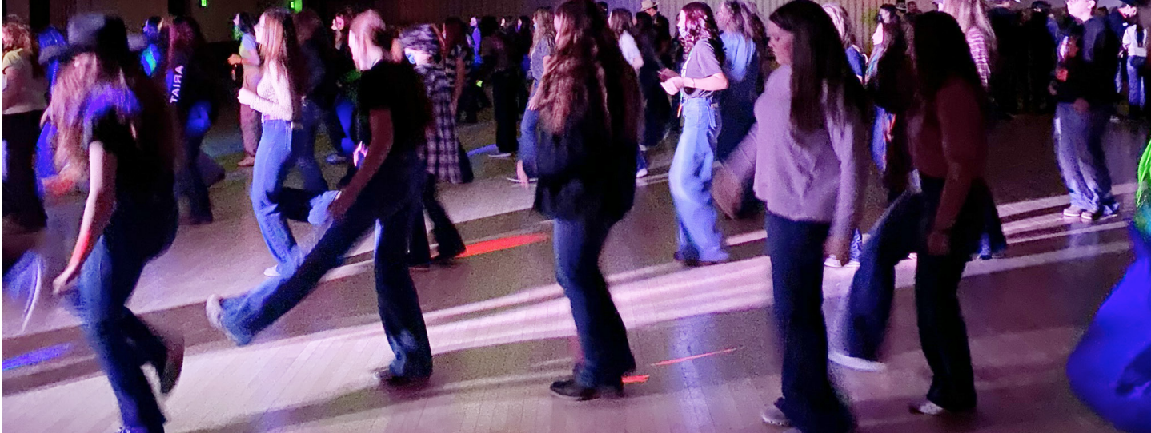
Dances
The State 4-H Leadership Team hosts two dances at Senior Leadership Retreat (SLR) designating a theme for each night.

Slide 12
Look for registration information at your
County Extension Office in the fall.

